Slide 1
CME 2003 Logic Design
Latch, Flip-flop

Slide 2
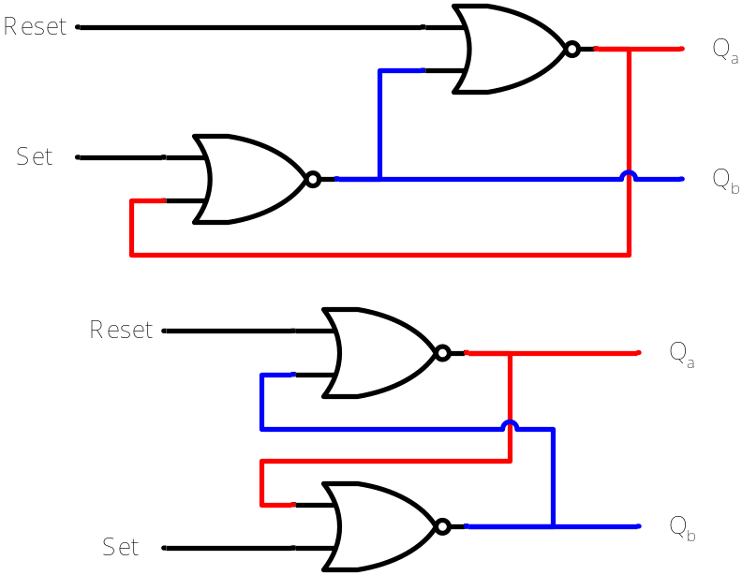
Basic Latch
Both circuit are the same
The only feedback path is the red line

Slide 3
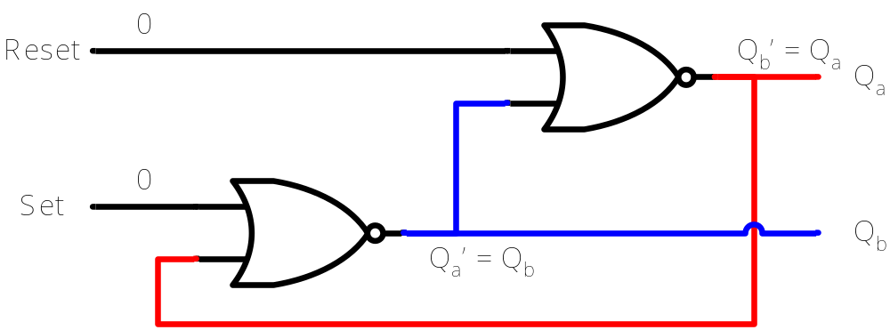
Basic Latch
Consider Set = 0, Reset =0

Slide 4
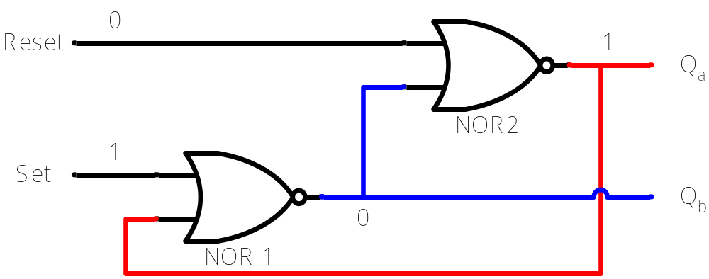
Basic Latch
Consider S = 1, R =0
  As S=1, NOR1 output must be 0
  As NOR1 ouput = 0 and R =0, NOR2 output must be 1

Slide 5
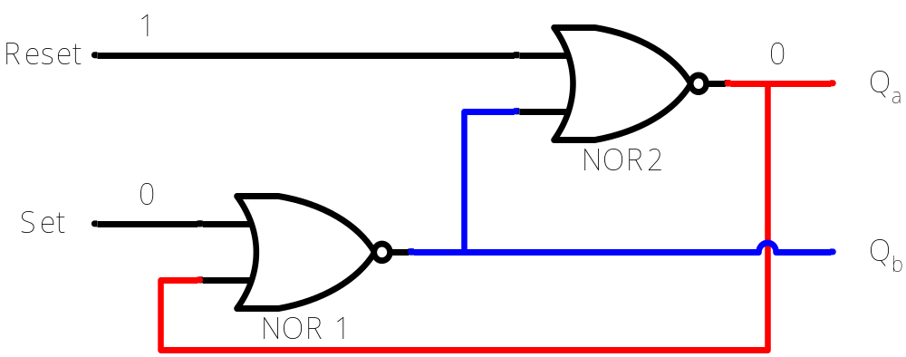
Basic Latch
Consider S = 0, R =1
  As R = 1, NOR2 output must be 0

Slide 6

Basic Latch
Consider R = 1 and S =1
  As R = 1, NOR2 output must be 0
  As S = 1, NOR1 output must be 0

Slide 7
Level sensitive and edge sensitive
For a latch and flip-flop (FF), it can be level sensitive or edge sensitive
  Level sensitive means the latch / FF will copy input D to output Q when Clk = 1
  Edge sensitive means that the latch / FF will only copy input D to output Q when Clk change from 0 -> 1 (positive edge trigger) / 1 -> 0 (negative edge trigger)

Slide 8
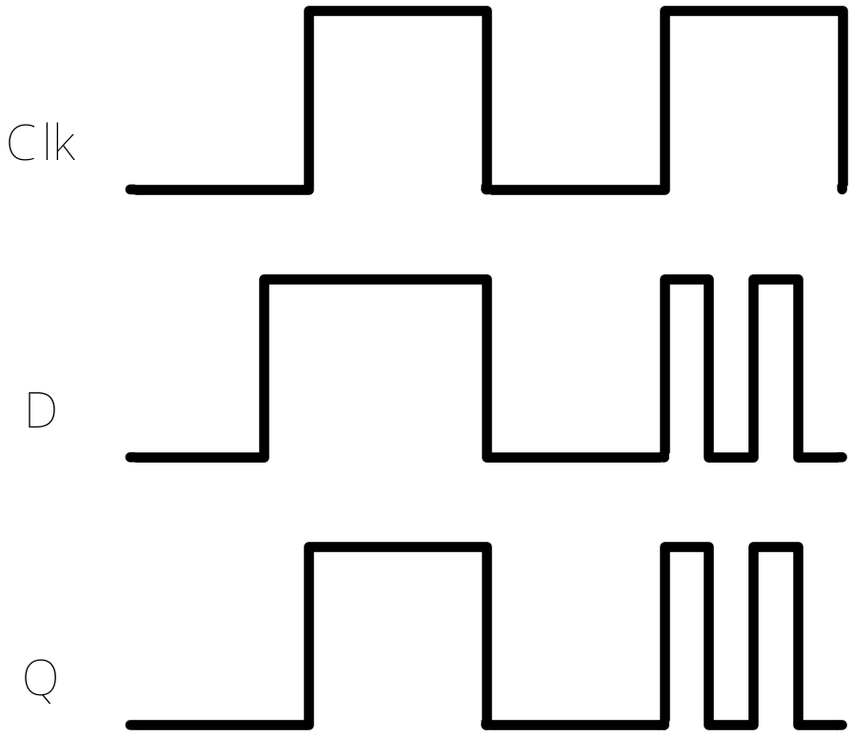
Level sensitive

Slide 9
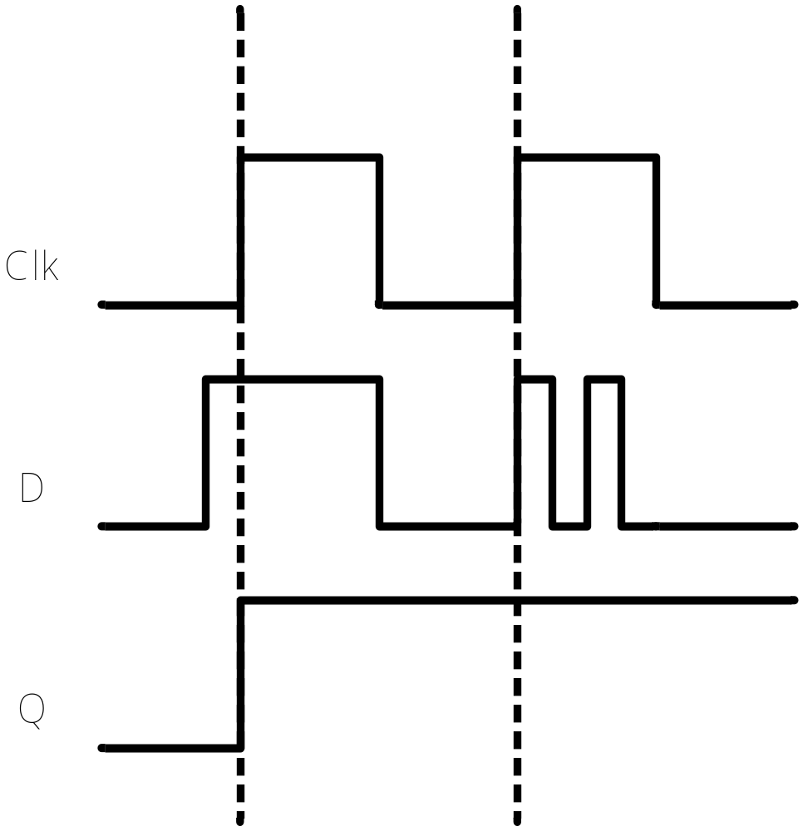
Edge sensitive

Slide 10
Review on basic latch
Truth Table for basic latch
  S R Qa Qb
  0 0 no change
  0 1 0 1
  1 0 1 0
  1 1 0 0
Also if input changed from S=1 R=1 to S=0 R=0, unstable case occur

Slide 11
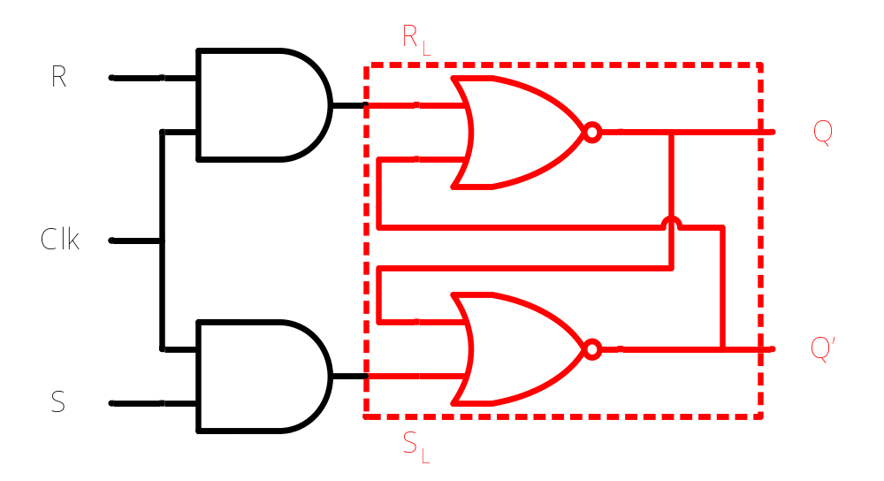
Gated SR latch
The red part is exactly the basic latch

Slide 12
Gated SR latch
Gated SR latch has truth table like that
  Clk S R Q(t+1) => S_{L} R_{L}
  0 x x Q(t) => 0 0
  1 0 0 Q(t) => 0 0
  1 0 1 0 => 0 1
  1 1 0 1 => 1 0
  1 1 1 x => x x
S_{L} = Clk AND S
R_{L} = Clk AND R

Slide 13
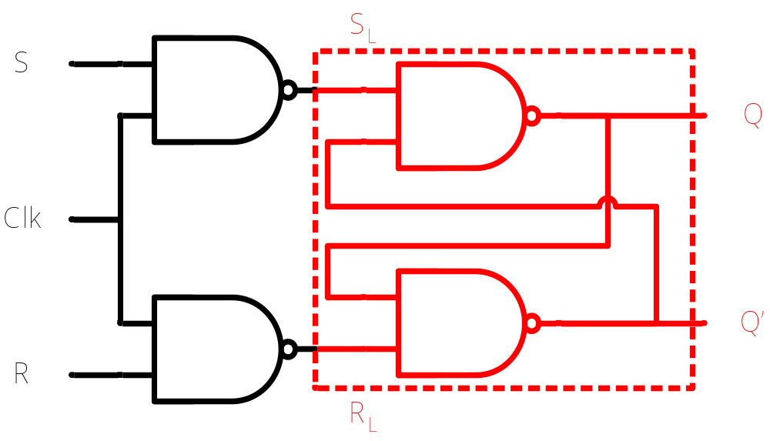
Gated SR latch
Gated SR latch that only use NAND gate
  Noted that S is at top instead of R compared to NOR version

Slide 14
Gated D latch
The follow truth table is the function we want for Gated D latch
  Clk D Q(t+1)
  0 x Q(t)
  1 0 0
  1 1 1

Slide 15
Gated D latch
Our gated D latch is guild from gated SR latch
Mapping the truth table from gated D latch to Gated SR latch
  Clk = 0, D = x => Clk = 0, S = x, R = x
  Clk = 1, D = 0 => Clk = 1, S = 0, R = 1
  Clk = 1, D = 1 => Clk = 1, S = 1, R = 0
From the above mapping, we found that S = D and R = NOT D
  We can build the circuit accordingly

Slide 16
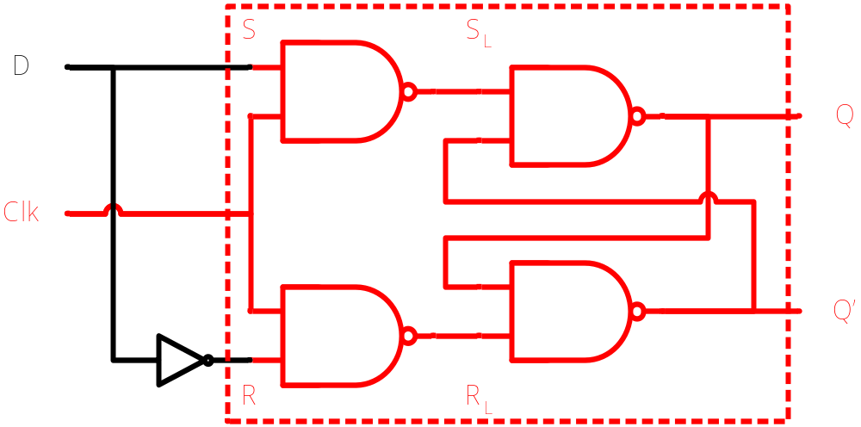
Gated D Latch
Red color part is gated SR latch
Noted that it is level sensitive

Slide 17
Flip-Flop
Flip-flop is a storage device that response to change from input exactly at the edge of clock signal
The output will be stabilized within clock cycle
Clock is an important input for electronic device
  Circuit do not have concept of date and time, it count how many clock cycle pass
  Clock signal need to accurate in the period

Slide 18
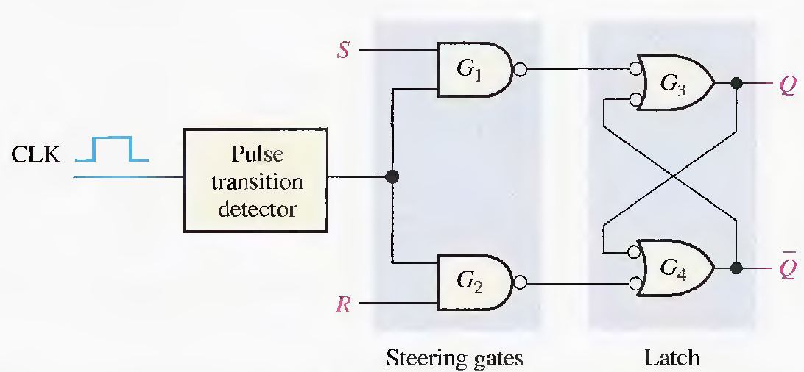
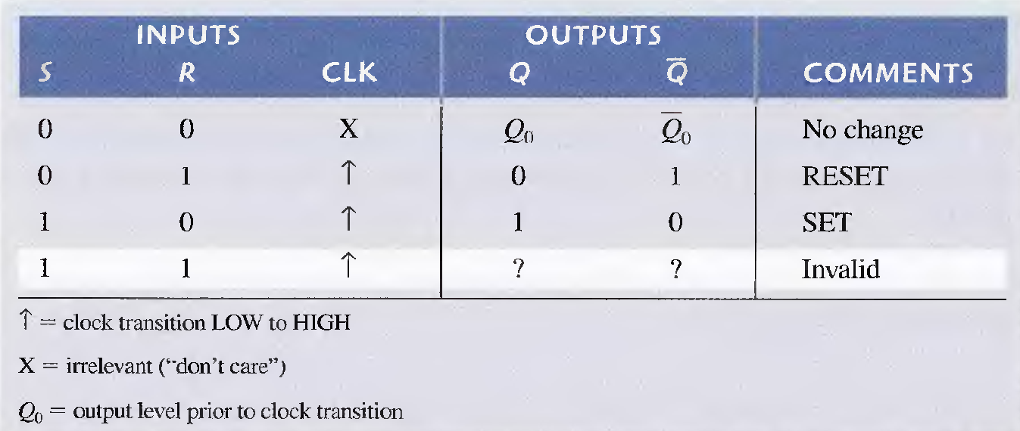
Edge-Triggered Flip-Flops
The Edge-Triggered S-R Flip-Flop

Slide 19
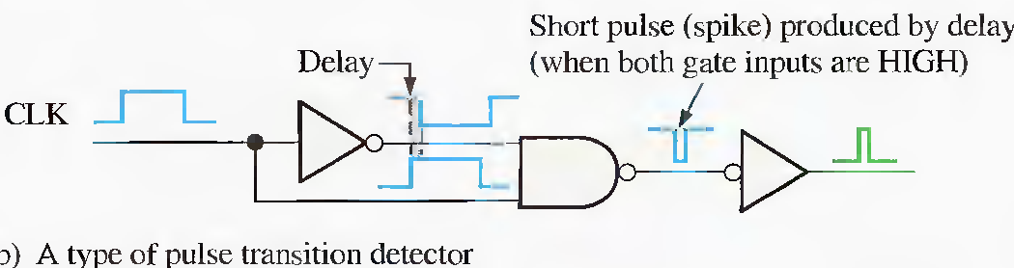
Pulse Transition Detector

Slide 20
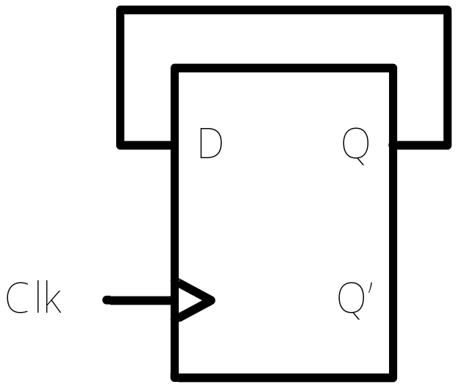
T Flip-Flop
Truth Table for T FF
  T Q(t+1)
  0 Q(t)
  1 Q(t)’
We build T FF from D FF
The circuit on the right do the following thing
  Q(t+1) = Q(t)

Slide 21
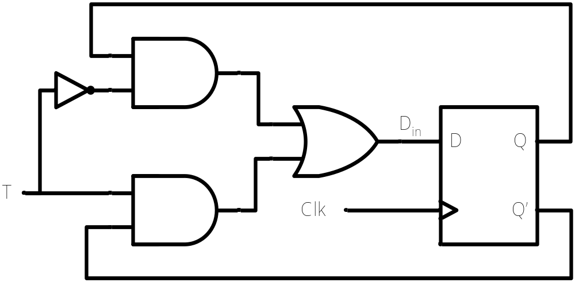
T Flip-Flop
Base on the circuit on last slide
  Din = T’Q + TQ’
  Q(t+1) = T’Q(t) + TQ’(t)

Slide 22
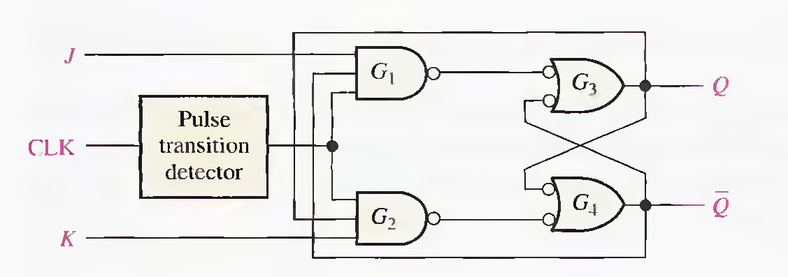
JK Flip-Flop

Slide 23
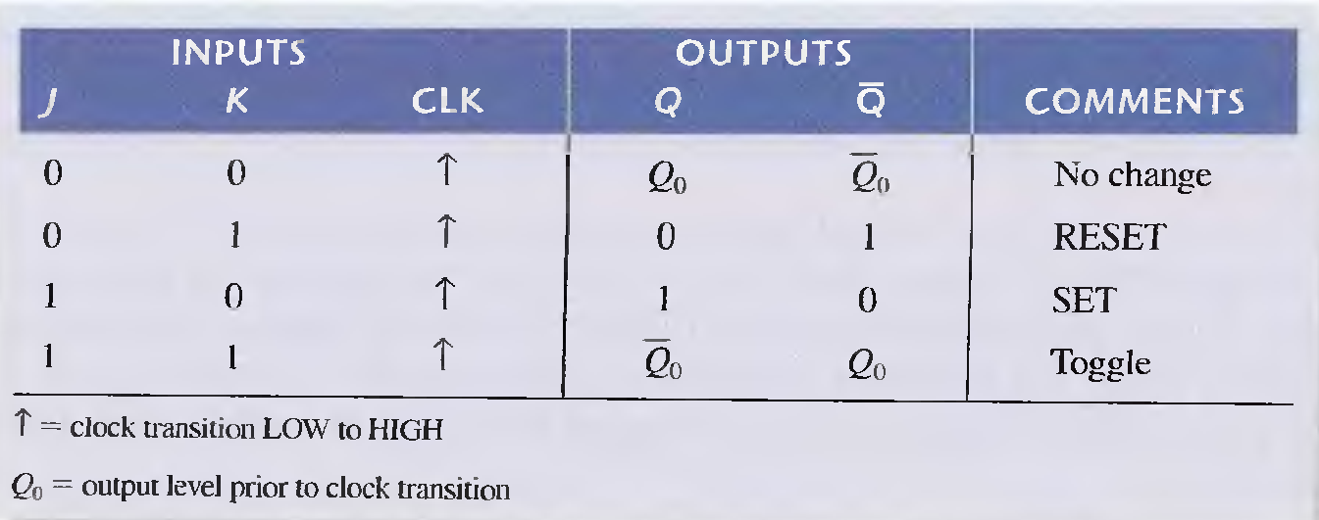
JK Flip-Flop by using SR Flip-Flop
J
1
S Q
R Q
C
2
K

Slide 24
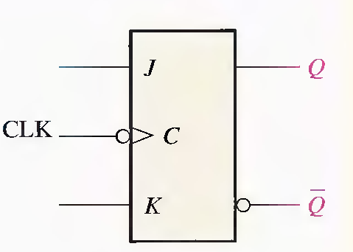
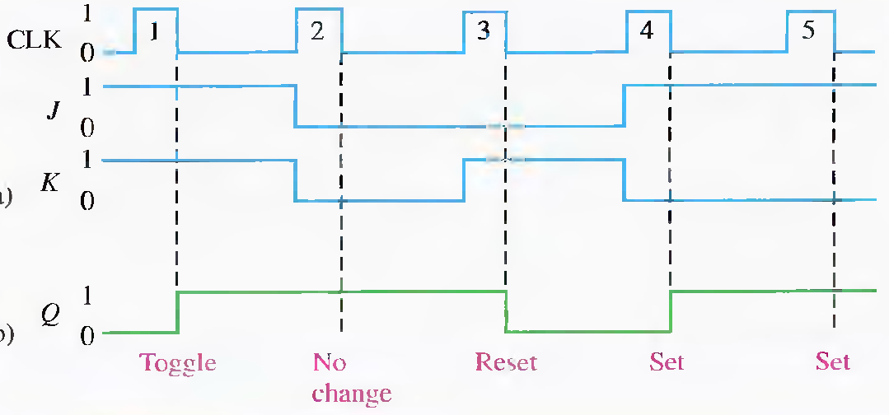
Example

Slide 25
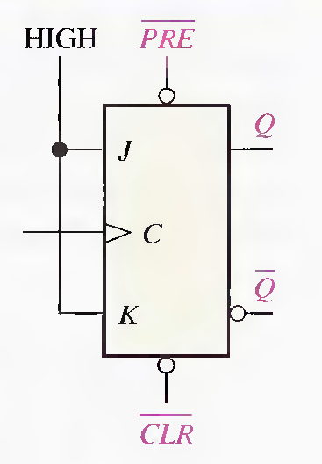
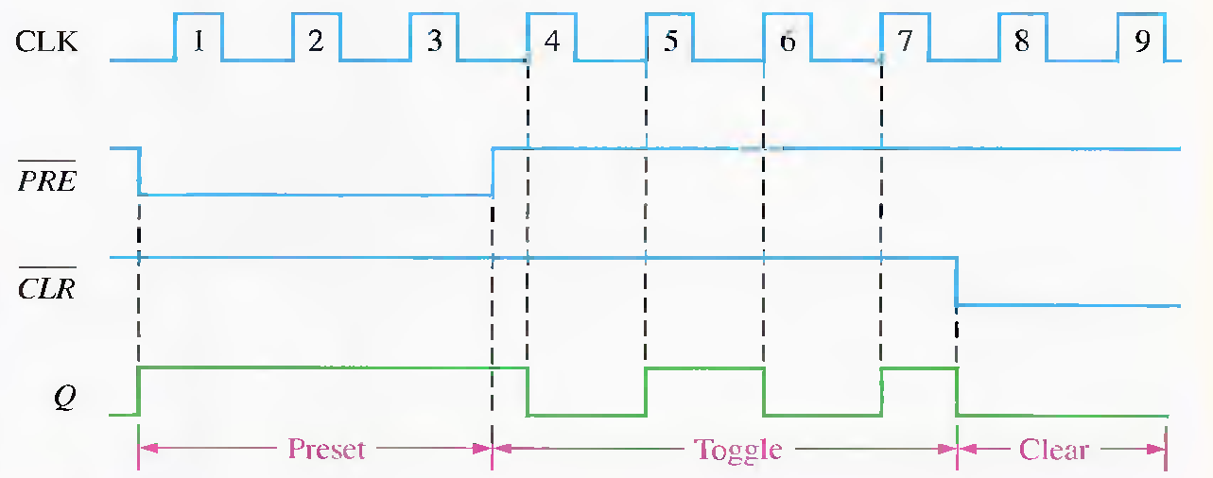
Asynchronous Preset and Clear Inputs

Slide 26
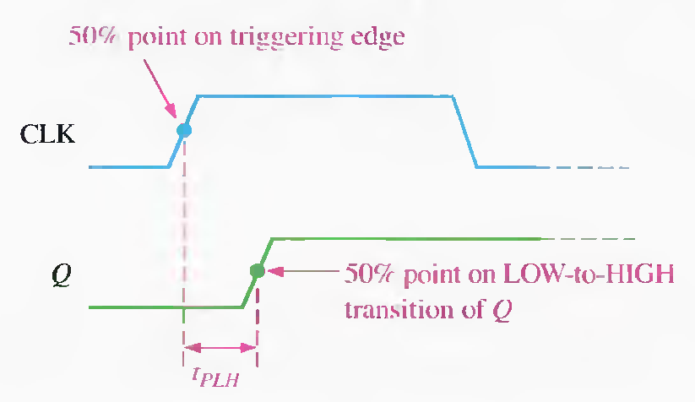
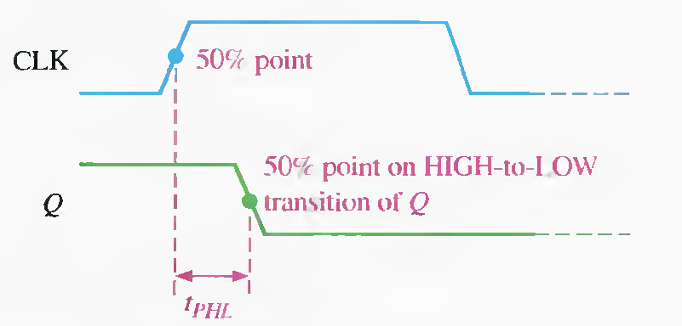
Propagation Delay Times ( tp )
the interval of time required after an input signal has been applied for the resulting output change to occur.
(a)
(b)

Slide 27
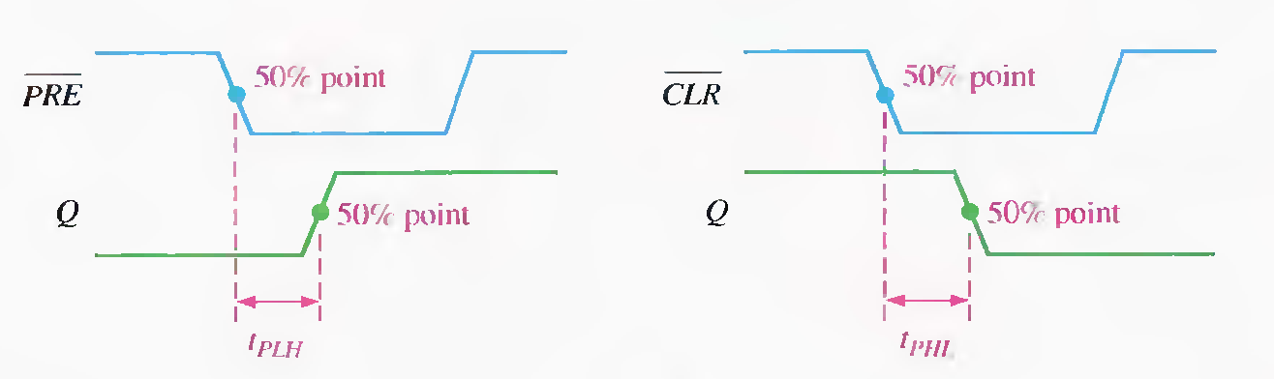
Propagation Delay Times …
(c)
(d)

Slide 28
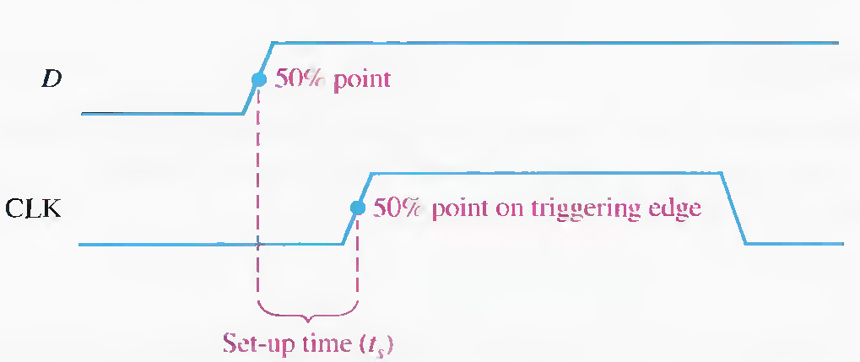
Set-up Time ( t_{s} )
the minimum interval required for the logic levels to be maintained constantly on the inputs (J and K, or Sand R, or D) prior to the triggering edge of the clock pulse in order for the levels to be reliably clocked into the flip-flop.

Slide 29
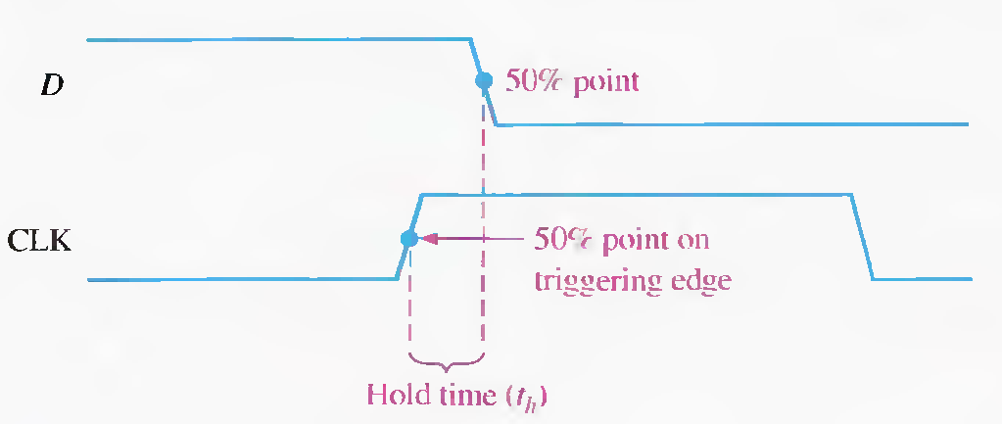
hold time ( t_{h} )
the minimum interval required for the logic levels to remain on the inputs after the triggering edge of the clock pulse in order for the levels to be reliably clocked into the flip-flop.

Slide 30
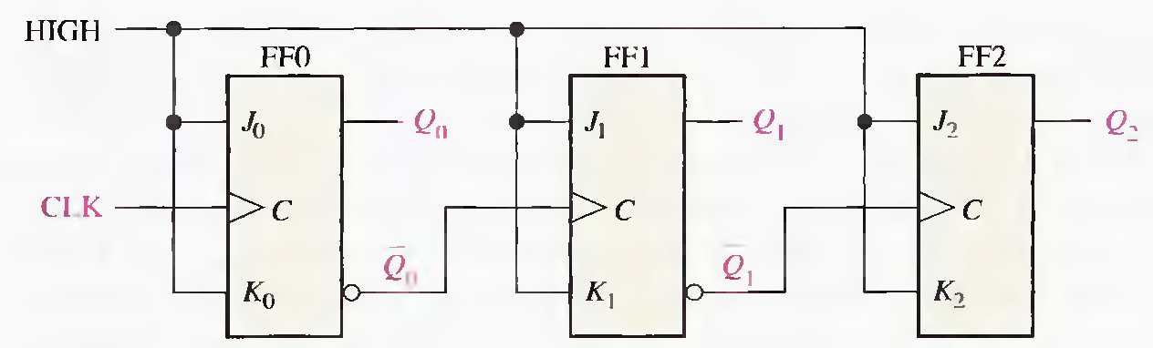
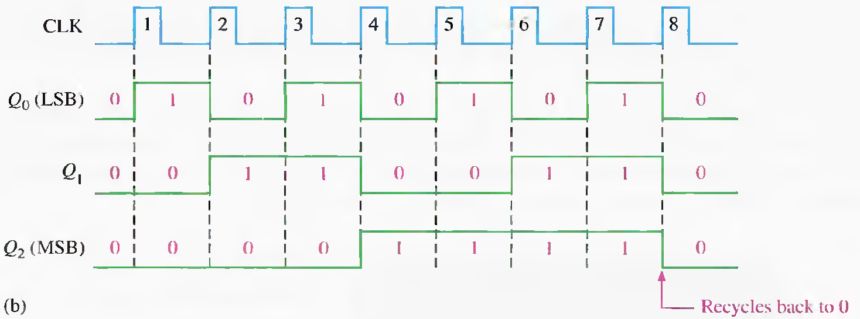
Asynchronous Counter

Slide 31
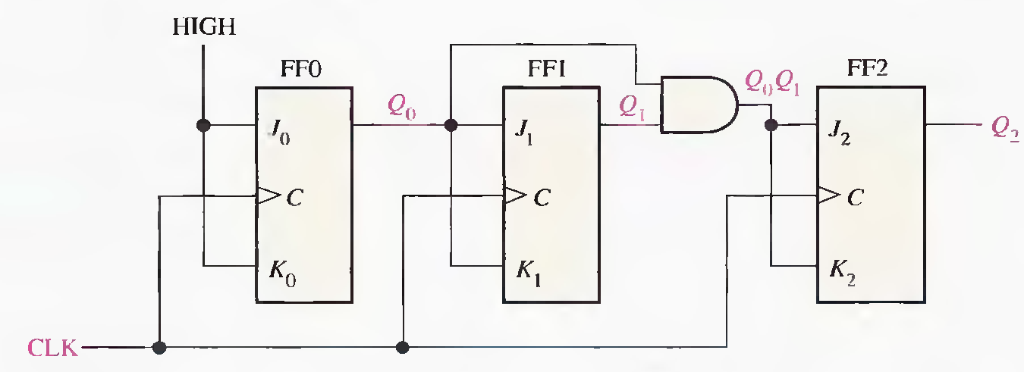
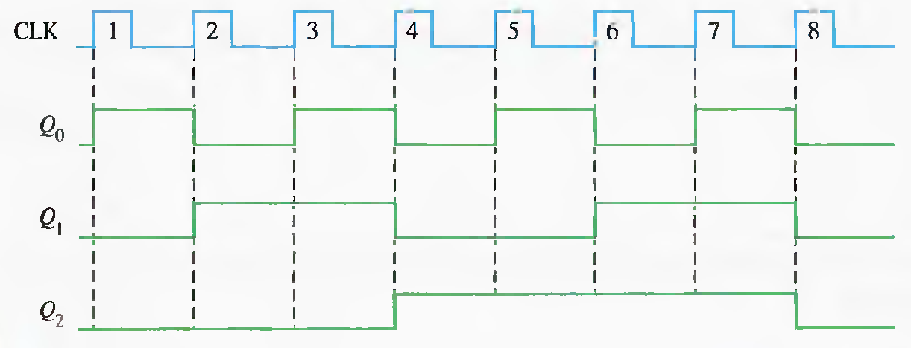
Synchronous Counter

Slide 32
Difference between Asynchronous and Synchronous Counter
Asynchronous Counter | Synchronous Counter
1. Clock input is applied to LSB FF. The output of first FF is connected as clock to next FF. | 1. Clock input is common to all FF.
2. All Flip-Flops are toggle FF. | 2. Any FF can be used.
3. Speed depends on no. of FF used for n bit . | 3. Speed is independent of no. of FF used.
4. No extra Logic Gates are required. Cost is less. | 4. Logic Gates are required based on design. Cost is more.

